Slide 1
Practice of Computer Vision
TA: Wonjong Jang, Janghun Jo

Slide 2
Orientation Anaconda Numpy Pytorch
10/05/2020
POSTECH Computer Graphics Lab.
<number>

Slide 3
OT
TA members
How to operate
10/05/2020
POSTECH Computer Graphics Lab.
<number>

Slide 4
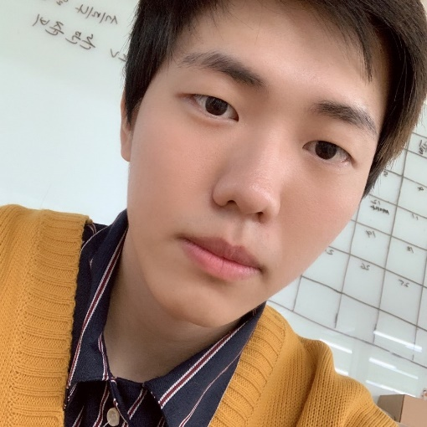
OT
TA members
Wonjong Jang
wonjong@postech.ac.kr
- POSTECH CSE Bachelor’s degree
- POSTECH CSE Master course
Research projects:
Face Beautification
Facial Image Super-resolution in-the-wild
GAN
3D Face
2D & 3D face manipulation (especially, caricature)
Homepage: http://cg.postech.ac.kr/
10/05/2020
POSTECH Computer Graphics Lab.
<number>
Notes:
<number>

Slide 5
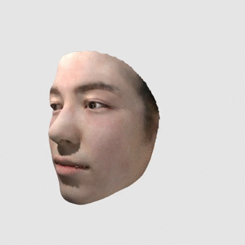
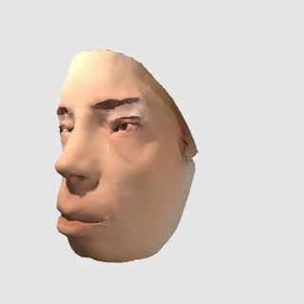
OT
TA members
Wonjong Jang
wonjong@postech.ac.kr
- POSTECH CSE Bachelor’s degree
- POSTECH CSE Master course
Research projects:
Face Beautification
Facial Image Super-resolution in-the-wild
GAN
3D Face
2D & 3D face manipulation (especially, caricature)
Homepage: http://cg.postech.ac.kr/
10/05/2020
POSTECH Computer Graphics Lab.
<number>
Notes:
<number>

Slide 6
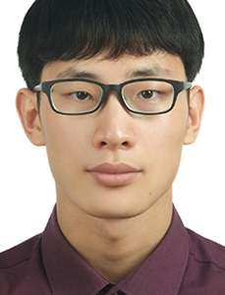
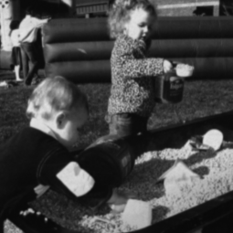

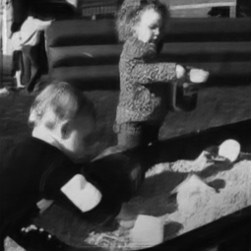
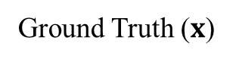
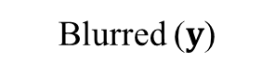
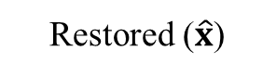
OT
TA members
Janghun Jo
jhjo432@postech.ac.kr
- DGIST ICE M.S.
- POSTECH CSE PhD Student
Research projects:
Image to Image translation
Deblurring
3D layout generation
Ground Truth ()
Blurred ()
Restored ()
Homepage: http://cg.postech.ac.kr/
10/05/2020
POSTECH Computer Graphics Lab.
<number>
Notes:
<number>

Slide 7
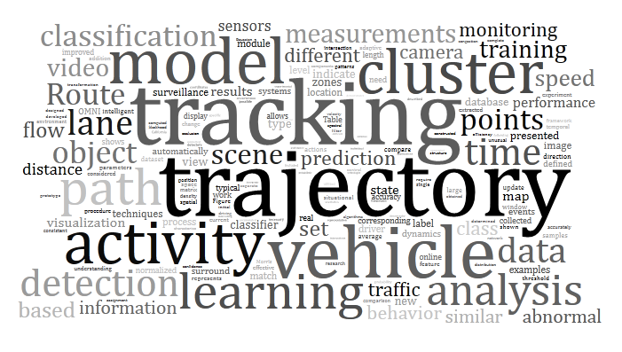

OT
Goal
대학원에서의 연구 목표 How could we solve a problem?
기업에서의 연구 목표 How could we exploit it?
실습에서의 배울 점 - How to solve a problem with Effective Method and High Performance. - How to apply your project with these skill
10/05/2020
POSTECH Computer Graphics Lab.
<number>

Slide 8
OT
How to operate
매 실습마다 제공하는 실습 자료마다 test case가 포함
실습 시간에 같이 할 수 있는 부분까지는 함께 진행
다 하지 못한 부분은 스스로 해결하여 제출
Test case 결과로 수강생 평가
10/05/2020
POSTECH Computer Graphics Lab.
<number>

Slide 9
Anaconda
Introduction
Making and Removing
Saving and Loading
10/05/2020
POSTECH Computer Graphics Lab.
<number>

Slide 10


What is the Anaconda?
Anaconda is an open source package management system and environment management system
Conda easily creates, saves, loads and switches between environments on your computer.
Conda as a package manager helps you find and install packages
10/05/2020
POSTECH Computer Graphics Lab.
<number>

Slide 11
Why we should use conda?
Linux is very sensitive to dependencies Ex)
You can run some code on python 3.6, but cannot run the others on python 3.6
You can run some code on Pytorch 0.4.0, but some code is run on Pytorch0.4.1 only
If you do not use conda, you should un-install and re-install other version package Ex)
Then, you cannot run the other code that needs original environments
10/05/2020
POSTECH Computer Graphics Lab.
<number>

Slide 12
Making and Remove
Installation
Download anaconda installer in https://www.anaconda.com/distribution/
bash Anaconda-latest-Linux-x86_64.sh
Make an new environment
conda create –n {desired name} python={desired version}
~/anaconda3/envs (이곳에 개별 버전들이 존재한다.)
Using an environment
source activate {desired env name}
source deactivate
Remove an environment
conda remove –n {desired env name} --all
10/05/2020
POSTECH Computer Graphics Lab.
<number>
Notes:
<number>

Slide 13
Save and Load
Saving an environment
source activate {env name}
Conda env export > {desired name}.yml
vim {desired name}.yml
Loading an environment
conda env create –n {desired env name} –f {env name}.yml
ACC
conda --version : anaconda 버전 확인
conda info : 현재 설치된 conda에 대한 정보 출력
conda info –e : 설치된 개발 환경 목록 출력
10/05/2020
POSTECH Computer Graphics Lab.
<number>

Slide 14
Why Pytorch
10/05/2020
POSTECH Computer Graphics Lab.
<number>

Slide 15
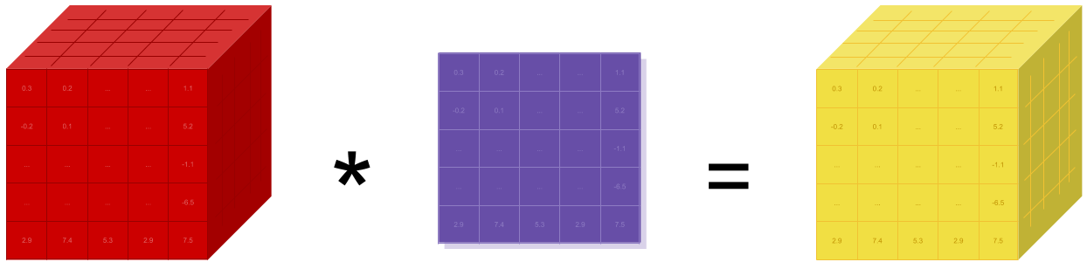
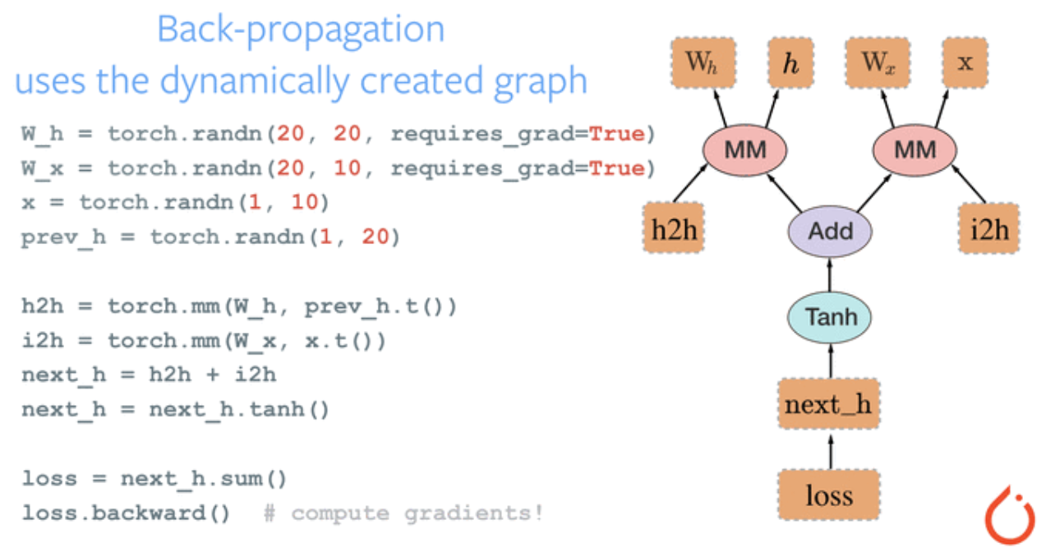
What Pytorch is
GPU ready Tensor Library (a.k.a Numpy)
Numpy의 matrix 연산을 따르기 때문에.
Dynamic computational graph (vs TF)
Change to Numpy!!
10/05/2020
POSTECH Computer Graphics Lab.
<number>
Notes:
<number>

Slide 16
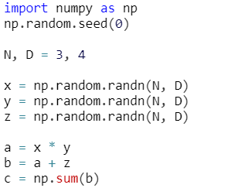
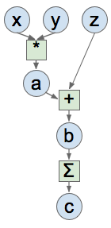
Computational graph - Numpy
<Numpy Code>
Creating Nodes!
Example from Lecture 8 in CS231n 2017, Fei-Fei Li & Justin Johnson & Serena Yeung
10/05/2020
POSTECH Computer Graphics Lab.
<number>
Notes:
<number>

Slide 17
Computational graph - Numpy
<Numpy Code>
Example from Lecture 8 in CS231n 2017, Fei-Fei Li & Justin Johnson & Serena Yeung
10/05/2020
POSTECH Computer Graphics Lab.
<number>
Notes:
<number>

Slide 18
Computational graph - Numpy
<Numpy Code>
Example from Lecture 8 in CS231n 2017, Fei-Fei Li & Justin Johnson & Serena Yeung
10/05/2020
POSTECH Computer Graphics Lab.
<number>
Notes:
<number>

Slide 19
Computational graph - Numpy
<Numpy Code>
Example from Lecture 8 in CS231n 2017, Fei-Fei Li & Justin Johnson & Serena Yeung
10/05/2020
POSTECH Computer Graphics Lab.
<number>
Notes:
<number>

Slide 20
Computational graph - Numpy
<Numpy Code>
Critical problem:
Manual gradient computation!
Example from Lecture 8 in CS231n 2017, Fei-Fei Li & Justin Johnson & Serena Yeung
10/05/2020
POSTECH Computer Graphics Lab.
<number>
Notes:
<number>

Slide 21
Computational graph - Numpy
<Numpy Code>
Critical problem:
Manual gradient computation!
Example from Lecture 8 in CS231n 2017, Fei-Fei Li & Justin Johnson & Serena Yeung
10/05/2020
POSTECH Computer Graphics Lab.
<number>
Notes:
<number>

Slide 22
Computational graph - Numpy
<Numpy Code>
Critical problem:
Manual gradient computation!
Example from Lecture 8 in CS231n 2017, Fei-Fei Li & Justin Johnson & Serena Yeung
10/05/2020
POSTECH Computer Graphics Lab.
<number>
Notes:
<number>

Slide 23
Computational graph - Numpy
<Numpy Code>
Critical problem:
Manual gradient computation!
Example from Lecture 8 in CS231n 2017, Fei-Fei Li & Justin Johnson & Serena Yeung
10/05/2020
POSTECH Computer Graphics Lab.
<number>
Notes:
<number>

Slide 24
Computational graph - Numpy
<Numpy Code>
Critical problem:
Manual gradient computation! + No access to GPUs
Example from Lecture 8 in CS231n 2017, Fei-Fei Li & Justin Johnson & Serena Yeung
10/05/2020
POSTECH Computer Graphics Lab.
<number>
Notes:
<number>

Slide 25
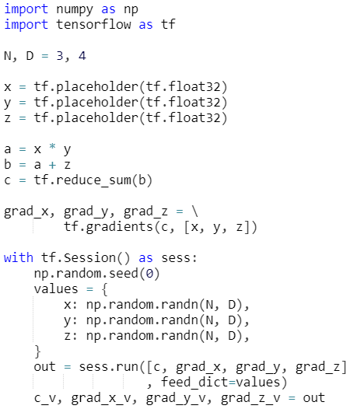
Computational graph - Tensorflow
<Numpy Code>
<Tensorflow Code>
Example from Lecture 8 in CS231n 2017, Fei-Fei Li & Justin Johnson & Serena Yeung
10/05/2020
POSTECH Computer Graphics Lab.
<number>
Notes:
<number>

Slide 26
Computational graph - Tensorflow
<Numpy Code>
<Tensorflow Code>
Example from Lecture 8 in CS231n 2017, Fei-Fei Li & Justin Johnson & Serena Yeung
10/05/2020
POSTECH Computer Graphics Lab.
<number>
Notes:
<number>

Slide 27
Computational graph - Tensorflow
<Numpy Code>
<Tensorflow Code>
Example from Lecture 8 in CS231n 2017, Fei-Fei Li & Justin Johnson & Serena Yeung
10/05/2020
POSTECH Computer Graphics Lab.
<number>
Notes:
<number>

Slide 28
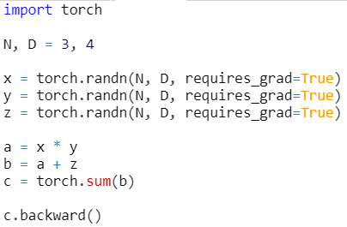
Computational graph - Pytorch
<Pytorch Code>
<Tensorflow Code>
Gradient computation becomes easy!!
Example from Lecture 8 in CS231n 2017, Fei-Fei Li & Justin Johnson & Serena Yeung
10/05/2020
POSTECH Computer Graphics Lab.
<number>
Notes:
<number>

Slide 29
Computational graph – Pytorch
<Pytorch Code>
<Tensorflow Code>
Even easier!!
Example from Lecture 8 in CS231n 2017, Fei-Fei Li & Justin Johnson & Serena Yeung
10/05/2020
POSTECH Computer Graphics Lab.
<number>
Notes:
<number>

Slide 30
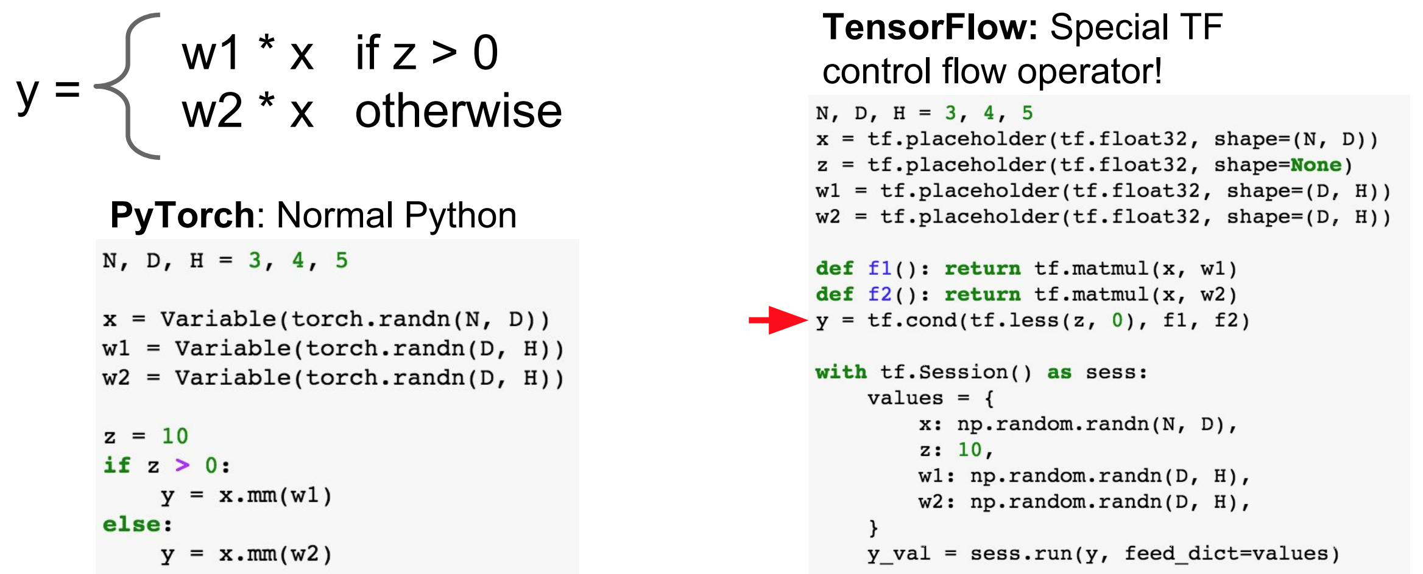
Computational graph – Pytorch vs TF
Dynamic computational graph - Conditional
Example from Lecture 8 in CS231n 2017, Fei-Fei Li & Justin Johnson & Serena Yeung
10/05/2020
POSTECH Computer Graphics Lab.
<number>
Notes:
<number>

Slide 31
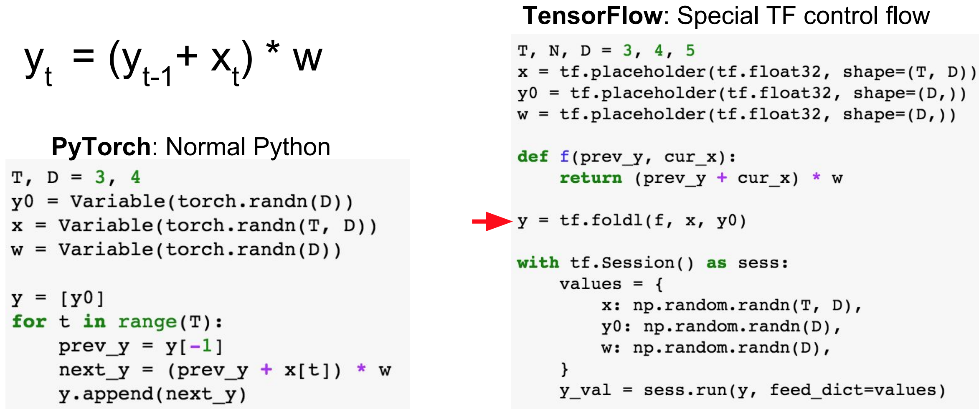
Computational graph – Pytorch vs TF
Dynamic computational graph - Loop
Example from Lecture 8 in CS231n 2017, Fei-Fei Li & Justin Johnson & Serena Yeung
10/05/2020
POSTECH Computer Graphics Lab.
<number>
Notes:
<number>

Slide 32
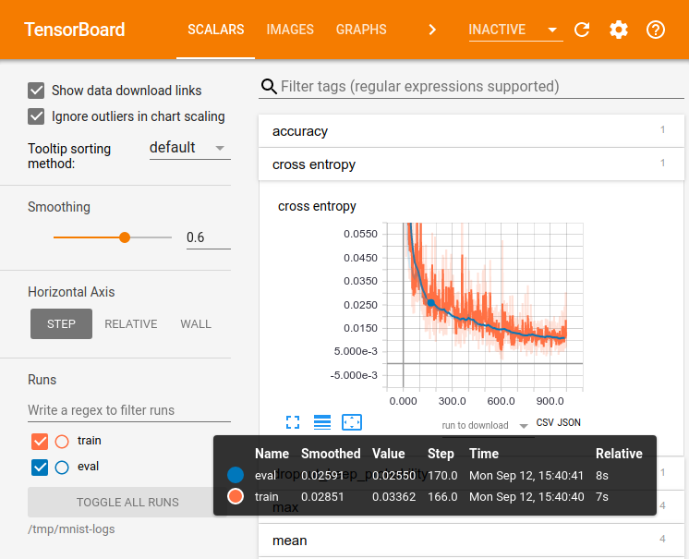
Computational graph – Pytorch vs TF
TensorBoard (Pytorch also)
- Pytorch 1.1.0 이전에는 tensorboardX 라는 library를 사용하여 실행
- Pytorch 1.1.0 부터는 from torch.utils.tensorboard import SummaryWriter 로 사용
- 교육 예정
Example from Lecture 8 in CS231n 2017, Fei-Fei Li & Justin Johnson & Serena Yeung
10/05/2020
POSTECH Computer Graphics Lab.
<number>
Notes:
<number>

Slide 33
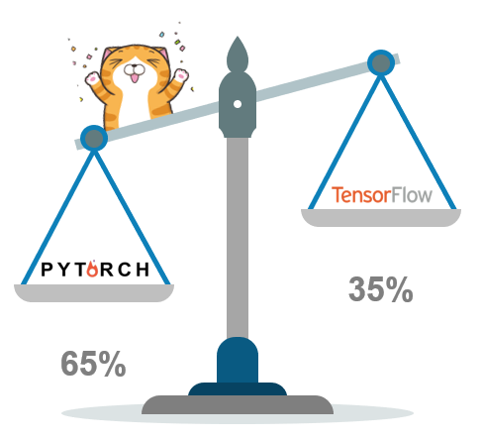
Computational graph – Pytorch vs TF
Summary
PyTorch
TensorFlow
Pythonic (easy to use)
Better to debug
Dynamic graph
TensorBoard(visualization)
Bigger community
10/05/2020
POSTECH Computer Graphics Lab.
<number>
Notes:
<number>

Slide 34
Pytorch Tutorial
with Numpy
10/05/2020
POSTECH Computer Graphics Lab.
<number>
Notes:
<number>

Slide 35
Briefly Numpy
Jupyter notebook
10/05/2020
POSTECH Computer Graphics Lab.
<number>

Slide 36
PyTorch Tutorial
PyTorch Components
Tensor
Autograd
nn
optim
and more
10/05/2020
POSTECH Computer Graphics Lab.
<number>
Notes:
<number>

Slide 37
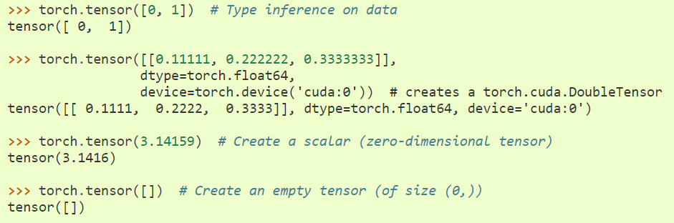
PyTorch Tutorial
Tensor
Tensor creation can be done with data, or do random initialization
10/05/2020
POSTECH Computer Graphics Lab.
<number>
Notes:
<number>

Slide 38
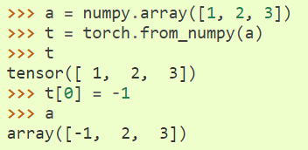
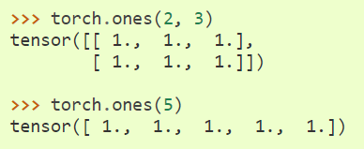
PyTorch Tutorial
Tensor
You can also create Tensor from a numpy array
Also many useful methods like ones, zeros, eyes, range, linspace, full, ...
Example from Lecture 8 in CS231n 2017, Fei-Fei Li & Justin Johnson & Serena Yeung
10/05/2020
POSTECH Computer Graphics Lab.
<number>
Notes:
<number>

Slide 39
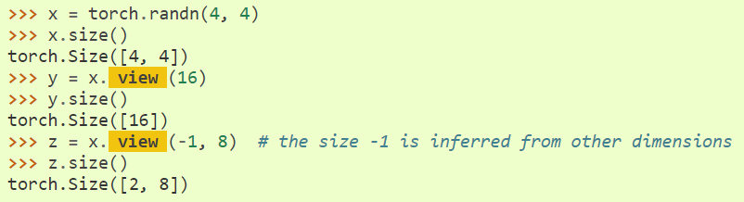
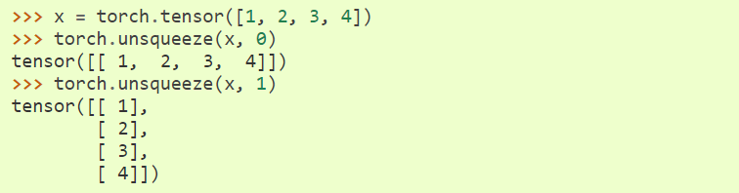
PyTorch Tutorial
Tensor
Supports indexing, slicing, joining and mutating operations
Supports Math/BLAS operations
Some frequently used methods: unsqueeze, view
Example from Lecture 8 in CS231n 2017, Fei-Fei Li & Justin Johnson & Serena Yeung
10/05/2020
POSTECH Computer Graphics Lab.
<number>
Notes:
<number>

Slide 40
Pytorch Practice TIME
Source Tensor
Our operation
Inserted Tenosr
10/05/2020
POSTECH Computer Graphics Lab.
<number>

Slide 41
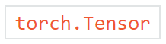
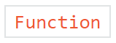
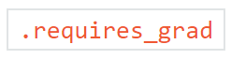
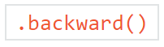
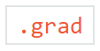
PyTorch Tutorial
Autograd - automated differentiation
: Interconnected with acrylic graph
: If True, track all the operations
: To automatically compute gradients of the tracked Tensors
: Gradient and its function are stored
10/05/2020
POSTECH Computer Graphics Lab.
<number>
Notes:
<number>

Slide 42
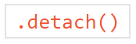
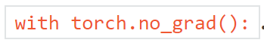
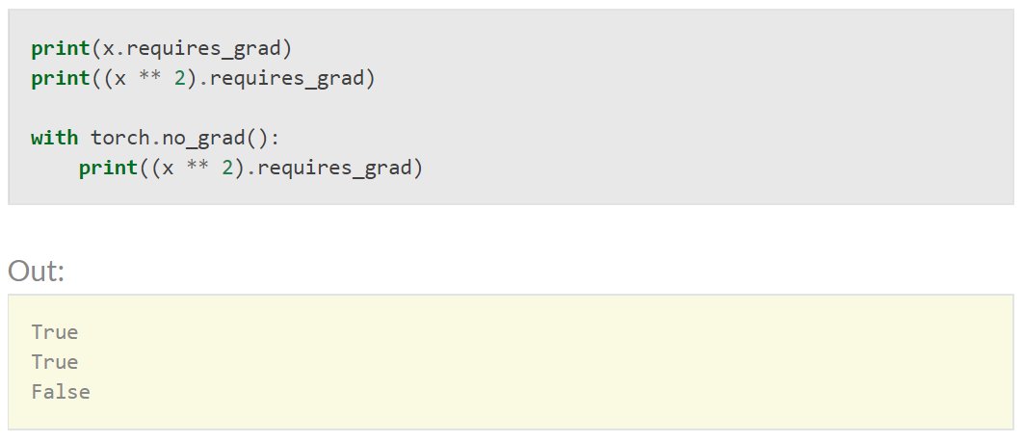
PyTorch Tutorial
Autograd - automated differentiation
: To stop gradient computation
: To stop gradient computation of the whole block
10/05/2020
POSTECH Computer Graphics Lab.
<number>
Notes:
<number>

Slide 43
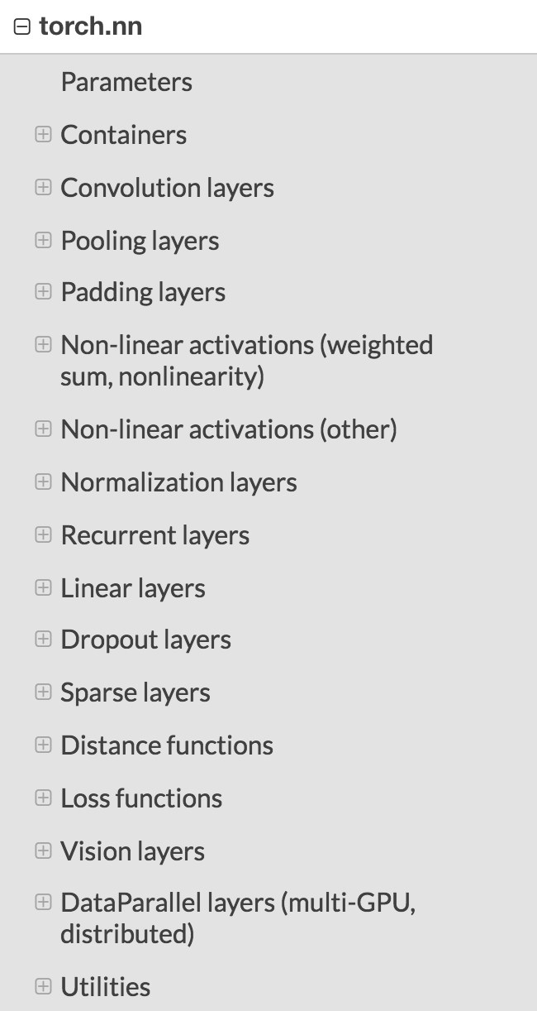
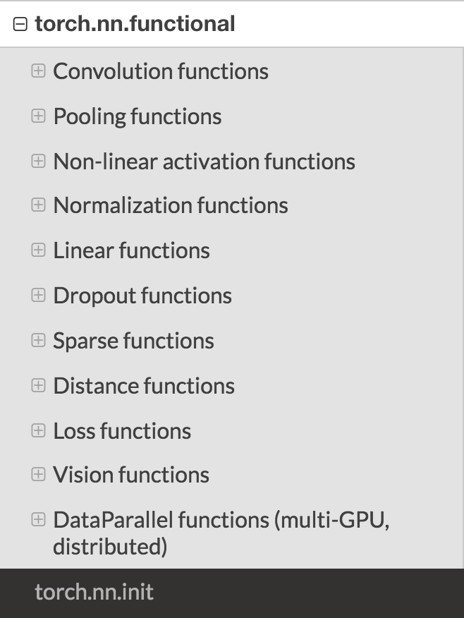
PyTorch Tutorial
nn Package
Everything related to NN
To arrange the computation into layers with contain learnable parameters
10/05/2020
POSTECH Computer Graphics Lab.
<number>
Notes:
<number>

Slide 44
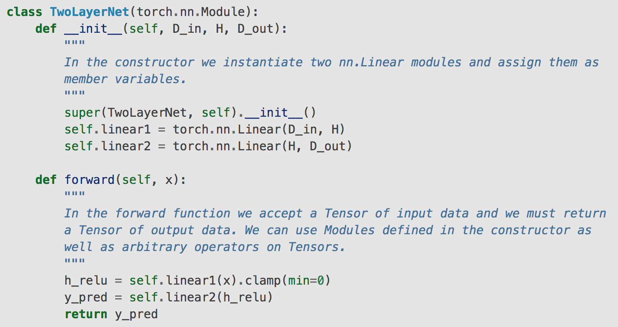
PyTorch Tutorial
Custom nn.Module
Example from Lecture 8 in CS231n 2017, Fei-Fei Li & Justin Johnson & Serena Yeung
10/05/2020
POSTECH Computer Graphics Lab.
<number>
Notes:
<number>

Slide 45
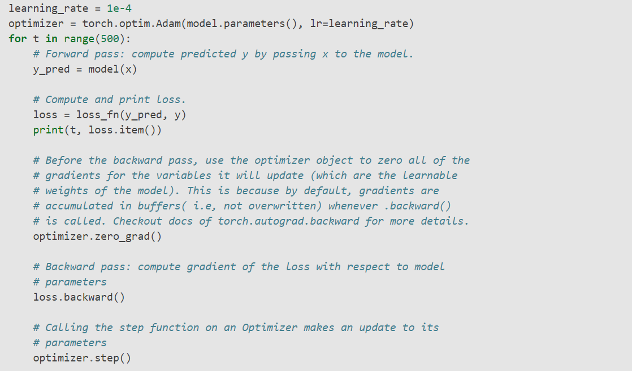
PyTorch Tutorial
optim
10/05/2020
POSTECH Computer Graphics Lab.
<number>
Notes:
<number>

Slide 46
PyTorch Tutorial
Neural Network with Pytorch
Define the Network
Loss Function
Backprop
Update the weight
10/05/2020
POSTECH Computer Graphics Lab.
<number>
Notes:
<number>

Slide 47
PyTorch Tutorial
무작정 따라하기
1. Single layer network
2. Multi layer network
Output
Input image
FC
1x28x28
1x10
Output
Input image
Conv5x5
Relu
MaxPool
Conv5x5
Relu
MaxPool
FC
FC
FC
1x28x28
1x10
10/05/2020
POSTECH Computer Graphics Lab.
<number>

Slide 48
PyTorch Tutorial
Neural Network with Pytorch
Dataset & DataLoader class
Define the Network (nn.Module)
Loss Function (MSE Loss, CE Loss)
Backprop (Optimizer(SGD, Adam) & scheduling)
Update the weight
10/05/2020
POSTECH Computer Graphics Lab.
<number>
Notes:
<number>

Slide 49
PyTorch Tutorial
1. Define the Network
Define the network class which inherit nn.Module
We should define the forward function, then the backward function is automatically defined using autograd
Of course, you can define own backward function yourself
The input to the forward is an autograd.Variable, and so is the output
10/05/2020
POSTECH Computer Graphics Lab.
<number>
Notes:
<number>

Slide 50
PyTorch Tutorial
2. Loss Function
Loss function takes the (output, target) pair of inputs
Computes a value that estimates how far away the output is from the target
There are several different loss functions under the nn package
Of course, you can also define your own loss function which is same character with network
10/05/2020
POSTECH Computer Graphics Lab.
<number>
Notes:
<number>

Slide 51
PyTorch Tutorial
3. Backprop
To back-propagate the error all we have to do is to loss.backward()
10/05/2020
POSTECH Computer Graphics Lab.
<number>
Notes:
<number>

Slide 52
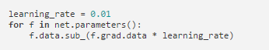
PyTorch Tutorial
4. Update the weight
We can implement using simple python code
However, as you use neural networks, you want to use various different update rules such as SGD, Adam, etc.
torch.optim implements all these optimization methods
optimizer.step() after loss.backward()
10/05/2020
POSTECH Computer Graphics Lab.
<number>
Notes:
<number>

Slide 53
PyTorch Tutorial
Datasets and DataLoader
All datasets are subclass of torch.utils.data.Dataset
You can make your own datasets to inherit Dataset class
We will discuss about it next class
Some famous datasets is provided in torchvision.datasets
DataLoader reads datasets and make the batch
for batch_idx, (input) in enumerate(data_loader)
10/05/2020
POSTECH Computer Graphics Lab.
<number>
Notes:
<number>

Slide 54
PyTorch Tutorial
Transform
Data augmentation technique
You can compose several data augmentation technique using transform
There are several transform function in torchvision.transforms
Of course, you can make your own transform, class which have __call__(self, img) method
10/05/2020
POSTECH Computer Graphics Lab.
<number>
Notes:
<number>

Slide 55
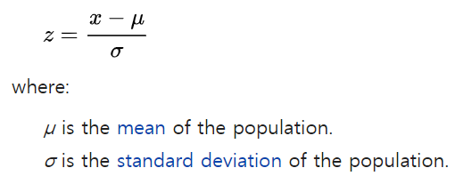
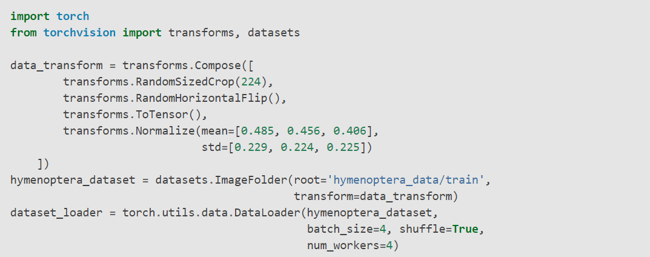
PyTorch Tutorial
Examples
Data augmentation technique
You can compose several data augmentation technique using transform
There are several transform function in torchvision.transforms
Of course, you can make your own transform, class which have __call__(self, img) method
10/05/2020
POSTECH Computer Graphics Lab.
<number>
Notes:
<number>

Slide 56
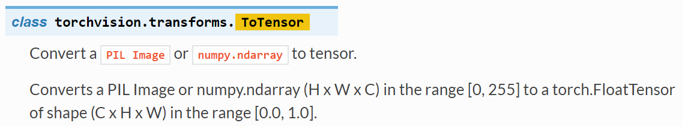
PyTorch Tutorial
Examples
Data augmentation technique
You can compose several data augmentation technique using transform
There are several transform function in torchvision.transforms
Of course, you can make your own transform, class which have __call__(self, img) method
10/05/2020
POSTECH Computer Graphics Lab.
<number>
Notes:
<number>

Slide 57
PyTorch Tutorial
Examples
Data augmentation technique
You can compose several data augmentation technique using transform
There are several transform function in torchvision.transforms
Of course, you can make your own transform, class which have __call__(self, img) method
10/05/2020
POSTECH Computer Graphics Lab.
<number>
Notes:
<number>

Slide 58
Thanks
10/05/2020
POSTECH Computer Graphics Lab.
<number>

